Slide 1
README for Project 2-1
FOOD 101 Classification
AI ToolKit
Fall Semester, 2023

Slide 2
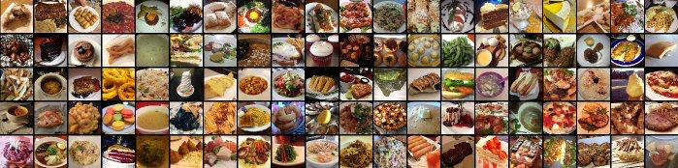
Task: Classification with FOOD 101 Dataset
To Do: Train a model that can classify each food photos!
i.e., apple pie, chocolate cake…

Slide 3
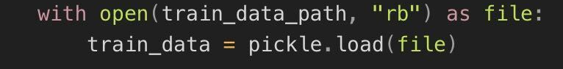
Data Specification
Input : 256 x 256 sized color images
Output : 101-dimensional vector, where 101 denotes the class numbers.
We provide train and validation data through the following:
train.zip & val.zip contain training and validation folders with images
train.pkl & val.pkl contain “path”, “id” and “label” information
When train_data_path = "train.pkl", you can read this file with the below code.
Check “test.ipynb” for checking how to read the provided data.

Slide 4
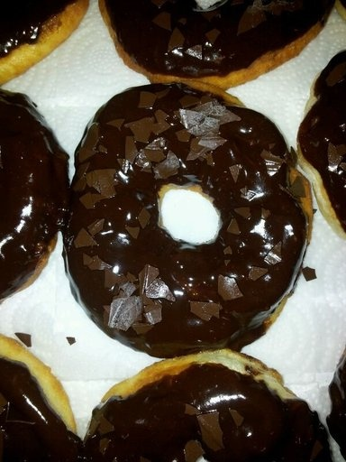
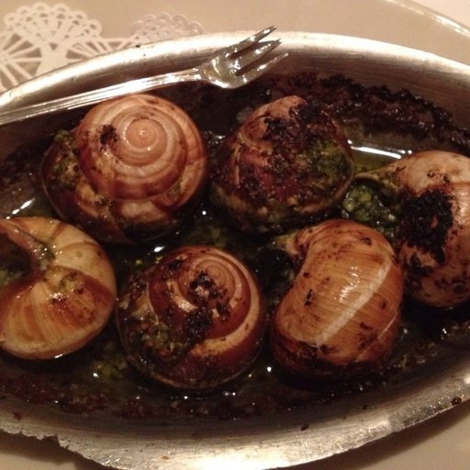
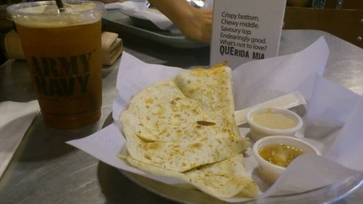
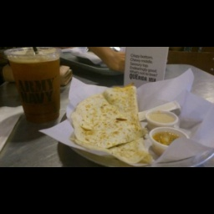
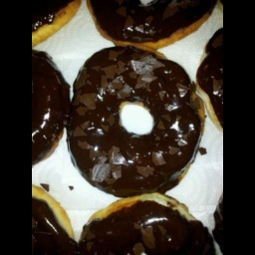

Data Specification
Training images have varied sizes.
We will define the image size as 256x256 in our test phase.
[Hint] Before data augmentation, try to pad the image while keeping the original height/width ratio.
Original
Resized

Slide 5
What should I do for this project?
Build your code for…
Custom dataset & dataloader.
Data augmentation.
Neural network model
Model training
Model saving
**Refer to the code materials provided in class**
** Use GPU for your training! (set runtime type of Google Colab as GPU)**
** Your model should be based on the deep learning model from our class material**
**Your model parameter number should not exceed 20 million**
Check your parameter number with def count_parameters(model): in utils.py

Slide 6
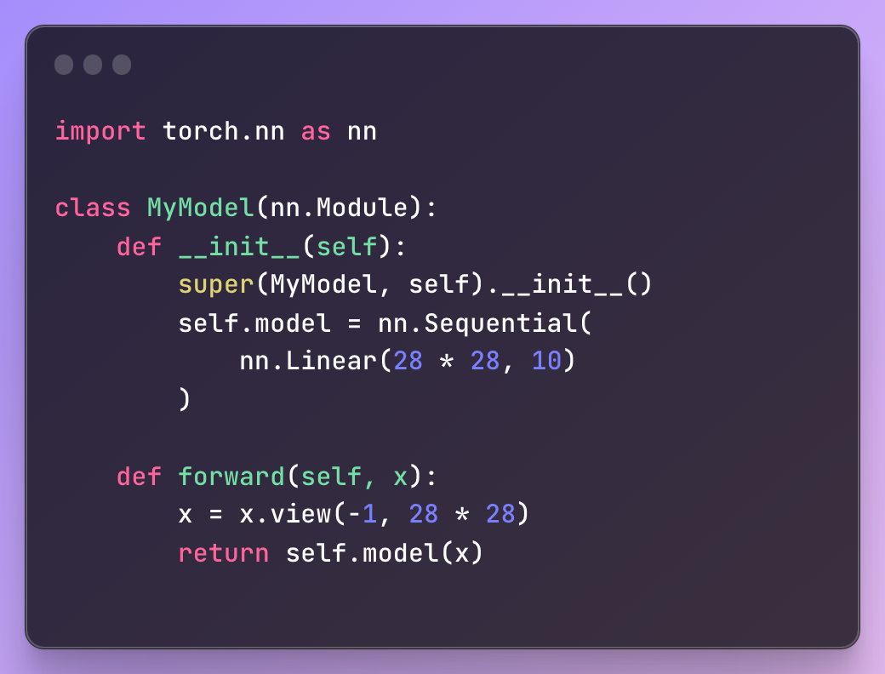
What should be submitted? (Same as project 1)
model.py
A python code defining your model class.
Your model class name should be MyModel.

Slide 7
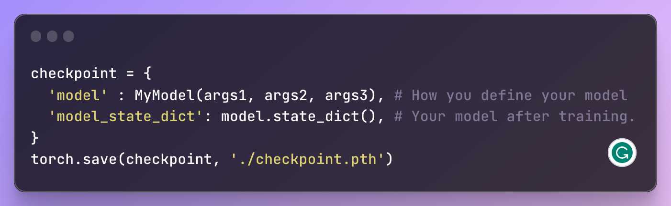
What should be submitted? (Same as project 1)
2. checkpoint.pth
.pth file that saves your model after training.
After finishing your training, use below code to save your model.
Here, MyModel(args1, args2, args3) should be modified depending on how your model should be defined.
The saved './checkpoint.pth' will be read by def load_checkpoint(filepath, device) in utils.py

Slide 8
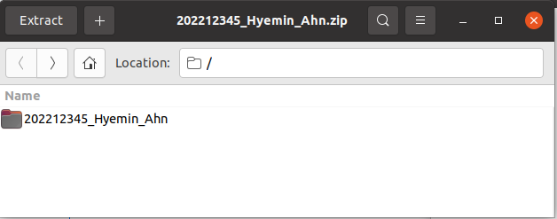
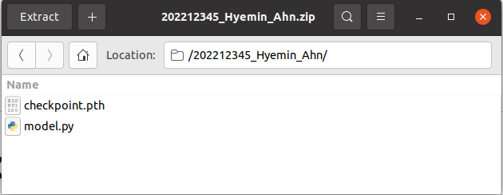
What should be submitted? (Same as project 1)
Build a directory named [student id]_[first name]_[last name].
For instance, my directory would be 202212345_Hyemin_Ahn
Please make your directory with this name format.
We are grading 120 students, so directory name out of this format might not be counted for grading.
Put model.py and checkpoint.pth to that directory
Zip that directory, and also name the zip file as [student id]_[first name]_[last name].zip ex) 202212345_Hyemin_Ahn.zip file

Slide 9
How to run test.ipynb
Upload (utils.py, model.py, checkpoint.pth, val.zip, val.pkl) to the file system.
Unzip the val.zip in your file system
Run the code and check if everything works smoothly.
Detailed how-to will be shown in the class!
When you are using Colab, it would be better to upload your files into your Google Drive, and use the mount the Google Drive to your Colab.

Slide 10
Deadline and where to submit?
Deadline: 23:59, 17th December
Submit it to…
Assignment tab in Blackboard System

Slide 11
Any Questions?

